Slide 1
Automatic Trading Bot
Christopher Jean-Baptiste

Slide 2
Project Overview
Project Objective: To develop an automated trading bot for the MetaTrader 4 platform that analyzes market trends and executes trades based on predefined strategies.
Problem Statement: Manual trading can be time-consuming and error-prone. This bot aims to automate trading, improving efficiency and potentially increasing profits by leveraging algorithmic strategies.
The Automatic Trading Bot project focuses on implementing a fully automated solution for trading on MetaTrader 4 (MT4), allowing the bot to make trades without human intervention. By automating the decision-making process based on set rules, this bot enables real-time analysis and efficient trade execution. This project ultimately aims to minimize human error and optimize trading speed

Slide 3
Initial Plans and Goals
Initial Objectives
Create a trading bot capable of executing trades automatically.
Design a risk management system to control losses.
Automate buy/sell decisions based on algorithmic strategies
Expected Outcomes
An automated bot capable of live trading.
User-friendly backtesting with historical data.
Comprehensive risk assessment and management.

Slide 4
Project Timeline and Key Milestones
Timeline Overview
The project phases include research, design, implementation , testing, and final delivery.
Milestones
Major milestones include strategy design, backtesting, and live testing stages.

Slide 5
Project Management & Timeline
Tools Used
Github
Trello board for organizing tasks and progress updates
Timeline Overview
Week 1-2: Research and planning.
Week 3-5: Core development and initial testing.
Week 6-8: UI development.
Week 9+: Final testing, debugging, and optimizations.

Slide 6
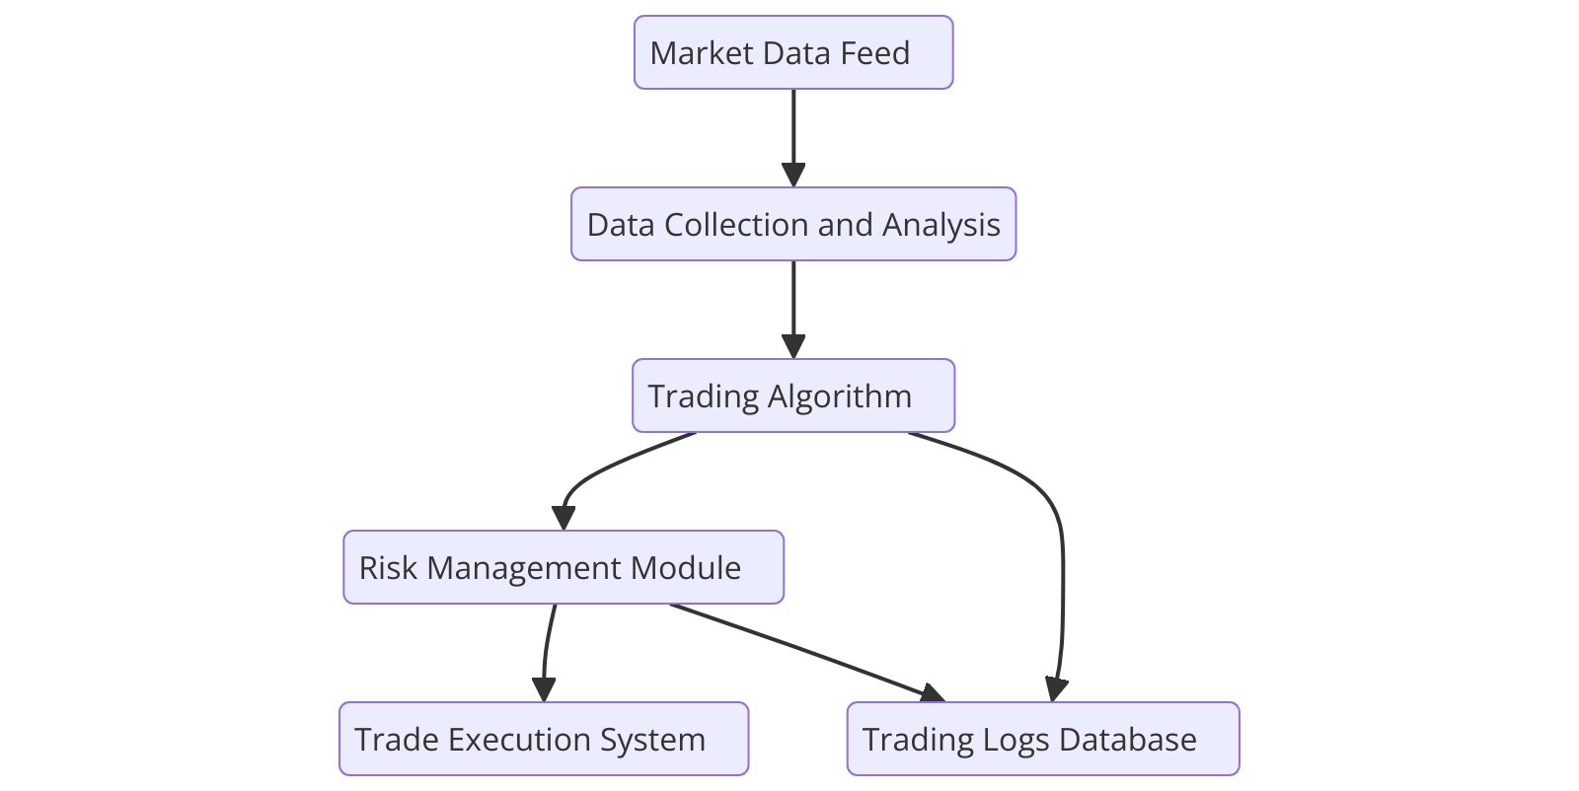
Technical Architecture & Diagram
Architecture Overview
Data Flow Diagram (DFD): Shows the flow of data from the input (market data) through different processing layers to the output (trade execution).
Trading Algorithm: Core decision-making logic.
Risk Management Module: Ensures controlled trade execution.

Slide 7
Market Data and Analysis
Data Sources: Live data and historical data is fed to the trading bot to support technical analysis and strategy testing
Technical Indicators: Uses moving averages, RSI and candlestick patterns for potential trades
Market Analysis: Continuously monitors market patterns for automated buy/sell decisions
The trading bot processes real-time market data to make informed trading decisions. With access to live data feeds and historical datasets, it can effectively track trends using technical indicators such as moving averages and RSI. The bot analyzes this data to spot market patterns and identifies optimal buy or sell opportunities, enhancing trade efficiency.

Slide 8
Trading Strategy Design
Key Strategies for Automated Decision Making
Moving Average Cross
Utilizes 13 and 50 Exponential Moving Average (EMA) values
Pullback Strategy
Executes trades on price pullbacks
Stop-Loss and Take-Profit
Automates risk management with preset price targets to exit trades

Slide 9
Final Design / Product
Final Implementation
Fully functional trading bot with real-time market analysis.
Completed UI for displaying account status, trade activity, and backtesting results.
Trade automation
Current Features
Customizable risk parameters.
Risk Management System

Slide 10
Key Code Snippets & Challenges
// Sample of the trading logic to execute a buy order
if (MarketCondition == "Bullish" && RiskLevel < MaxRisk) {
OrderSend(Symbol(), OP_BUY, LotSize, Ask, Slippage, StopLoss, TakeProfit);
}
Challenge: Ensuring real-time data syncing without delays in execution
Solution: Optimized code structure and minimized external data calls to improve speed

Slide 11
Key Code Snippets & Challenges
During development, I encountered a critical issue with the Risk Management System. The goal was to ensure trades closed if they exceeded the allowed duration, but the logic was occasionally failing. Specifically, the stop-loss wasn’t moving to break-even consistently, causing unexpected losses. Debugging this involved pinpointing when and why “StopMovedToBreakEven” was not triggering correctly.
Challenge: Ensure that the stop-loss moves to break-even only when the trade has a positive profit after a specific time interval.
The “ManageOpenTrade” function checks if the open trade duration exceeds the maximum allowed time. If it does, and the trade is in profit, it moves the stop-loss to the break-even point to secure gains. However, if the trade is negative, it closes the position to minimize loss.
Issue Faced: The stop-loss occasionally failed to move to break-even due to timing mismatches in “OrderModify”. This caused inconsistent trade outcomes, as the break-even logic didn’t always execute correctly. To fix it, I implemented additional checks and error handling for reliable stop-loss updates.

Slide 12
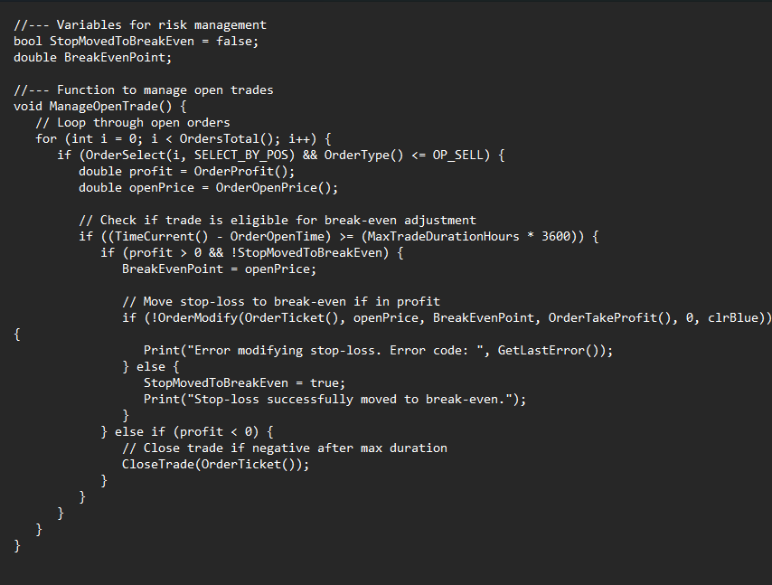
Key Code Snippets & Challenges

Slide 13
Learning Curve
Significant time learning MQL4 for Metatrader 4 Scripting
Additional Time invested in backtesting
Learning MQL4 and adapting to the MetaTrader 4 platform have been both challenging and rewarding. Developing fluency in MQL4 was essential for the complex decision-making logic required in the bot.

Slide 14
Time Log Overview
Total Time Spent
Research and Planning: ~20 hours
Development and Testing: ~50 hours
UI Design and User Testing: ~15 hours

Slide 15
Project Impact
Error Reduction: Automation minimizes human error in fast-paced trading decisions
Improved Trading Speed: Reduces manual trading time by executing trades at optimal times without delays
Increased Efficiency: Automates repetitive tasks, allowing traders to focus elsewhere
Improves accuracy in risk management
This automated trading bot has significantly impacted the trading workflow, reducing error rates and optimizing trade timings. By automating buy/sell decisions, the bot cuts down on reaction time, critical in high-frequency trading environments. Additionally, the bot frees up traders from repetitive tasks, ultimately enhancing overall trading efficiency.

Slide 16
Project Resources
Github Repository: chrisbaptiste27/AutoTradeBot
Project Board: Algorithmic Trading Bot | Trello

